Slide 1
What’s the point
James Rawlinson
Director of Health Informatics

Slide 2
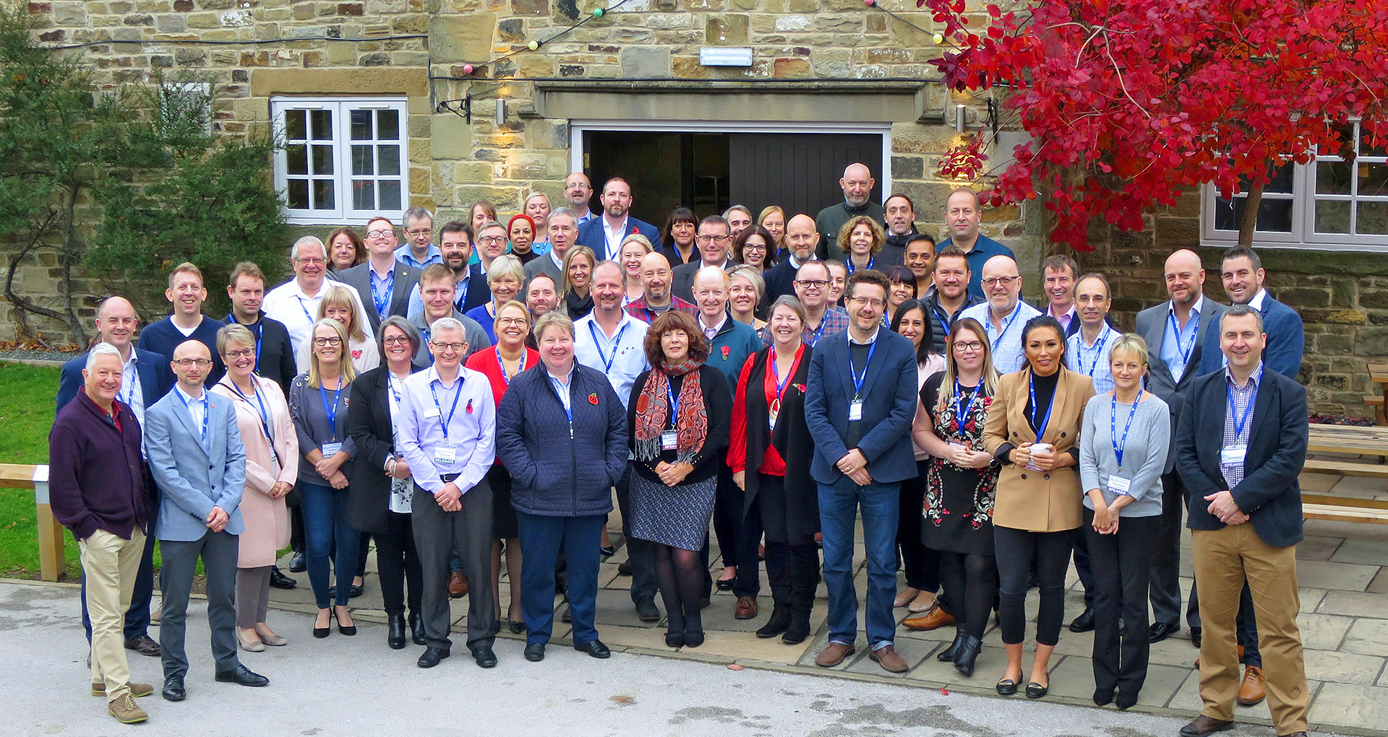
Constitution
The objectives of the Group are to support the work of its members, NHS and DH based organisations in the North-East, Yorkshire and Humber by:
Coordinating the views of members with the intention of providing more substantive input formally into the national programme and of taking action to influence the National IM&T agenda.
Working closely with the YatH DI Group to consider specific matters and make recommendations regarding implications and expectations of the service
Providing networking opportunities for members to support the sharing of good practice and expert knowledge
Providing a professional channel for communicating information and advising on National and Regional initiatives to those charged with implementing them.
Supporting the implementation of the national IM&T strategy and other National and Regional initiatives by:
providing a forum for consultation and discussion which can be used to influence,
nominating and supporting members to serve on Regional and National working groups,
undertaking or commissioning work which is of common benefit.
Promoting good practice and value for money by:
developing standards,
sharing experience and lessons learned,
developing the competence of IM&T staff,
addressing issues of common concern,
developing, planning and coordinating the implementation of initiatives,
acting as an IM&T reference point for other groups,
establishing useful links with other similar groups.

Slide 3
Constitution
The objectives of the Group are to support the work of its members, NHS and DH based organisations in the North-East, Yorkshire and Humber by:
Coordinating the views of members with the intention of providing more substantive input formally into the national programme and of taking action to influence the National IM&T agenda.
Working closely with the YatH DI Group to consider specific matters and make recommendations regarding implications and expectations of the service
Providing networking opportunities for members to support the sharing of good practice and expert knowledge
Providing a professional channel for communicating information and advising on National and Regional initiatives to those charged with implementing them.
Supporting the implementation of the national IM&T strategy and other National and Regional initiatives by:
providing a forum for consultation and discussion which can be used to influence,
nominating and supporting members to serve on Regional and National working groups,
undertaking or commissioning work which is of common benefit.
Promoting good practice and value for money by:
developing standards,
sharing experience and lessons learned,
developing the competence of IM&T staff,
addressing issues of common concern,
developing, planning and coordinating the implementation of initiatives,
acting as an IM&T reference point for other groups,
establishing useful links with other similar groups.

Slide 4
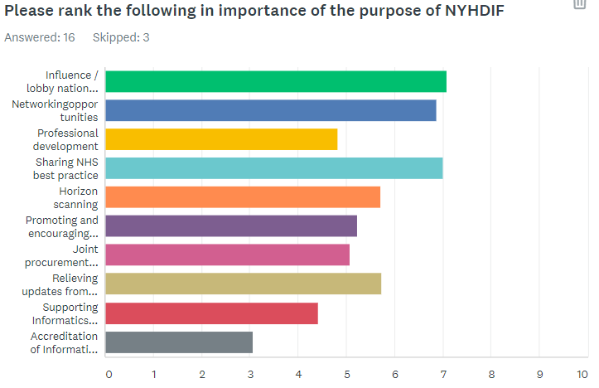
2017 survey

Slide 5
Membership ✓ ✓ ✓
Networking opportunities ✓
Coordinating the views of members -
Influence the National IM&T agenda. X
Sharing of good practice and expert knowledge ✓
Share experience and lessons learned ✓ X
Forum for consultation and discussion ✓
Addressing issues of common concern X
Act as IM&T Reference point ✓

Slide 6
How
Common ground and challenges
Support and Influence
Collective voice
Invite and expect v. NHSD Programme Directors
Yorkshire and Humber AHSN
Sharing
Encourage deputies
Spring ‘mini’ conference
10 minute quick fire of what we’ve done @ every meeting
Celebrate our successes as a collective

Slide 7
?

